Slide 1


Social Buzz
Data Analysis

Slide 2

Today's agenda
Project recap
Problem
The Analytics team
Process
Insights
Summary

Slide 3

Social Buzz is a fast growing technology unicorn that need to adapt quickly to it’s global scale. Accenture has begun a 3 month POC focusing on these tasks:
An audit of their big data practice
Recommendations for a successful IPO
An analysis of their content categories that highlights the top 5 categories with the largest aggregate popularity
Project Recap

Slide 4


Problem
Over 1,00,000 posts per day
36,500,000 pieces of content per year
But how to capitalize on it when there is so much ?
To highlight Social Buzz’s Top 5 content categories with largest aggregate popularity

Slide 5




Marcus Rompton
Senior Principal
The Analytics team
Michelle Grove
Data Scientist
Sruthi Maruboina
Data Analyst

Slide 6
Process
1
Data Understanding
2
Data Cleaning
3
Data Modelling
4
Data Analysis
5
Driving Insights

Slide 7


Insights
16
Unique Categories
1897
Reactions to “Animals” post
Photos
are the popular content type

Slide 8
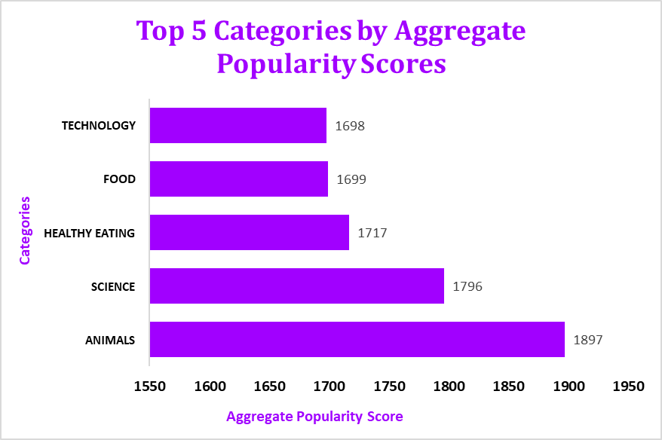

Slide 9
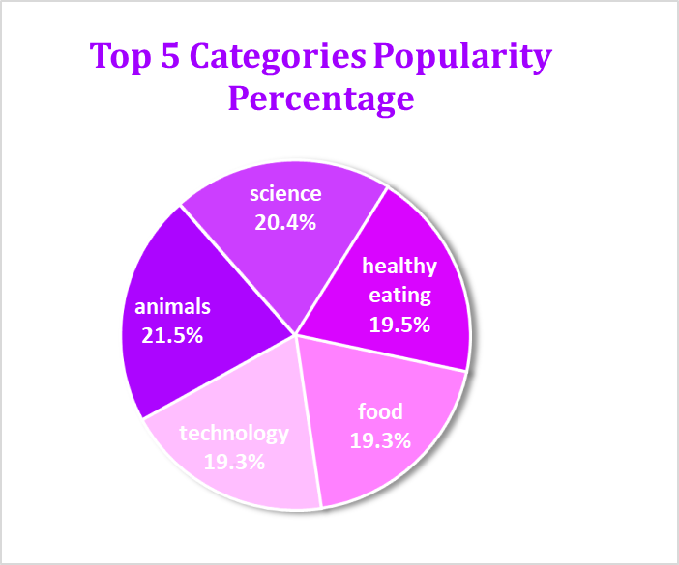
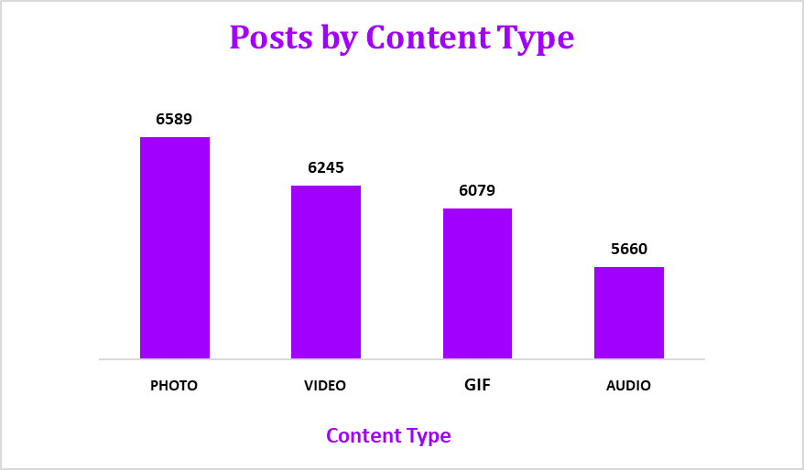
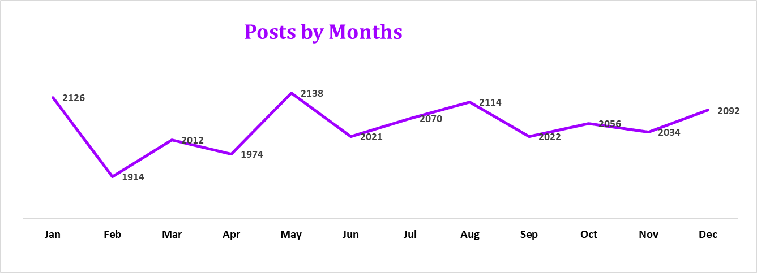

Slide 10


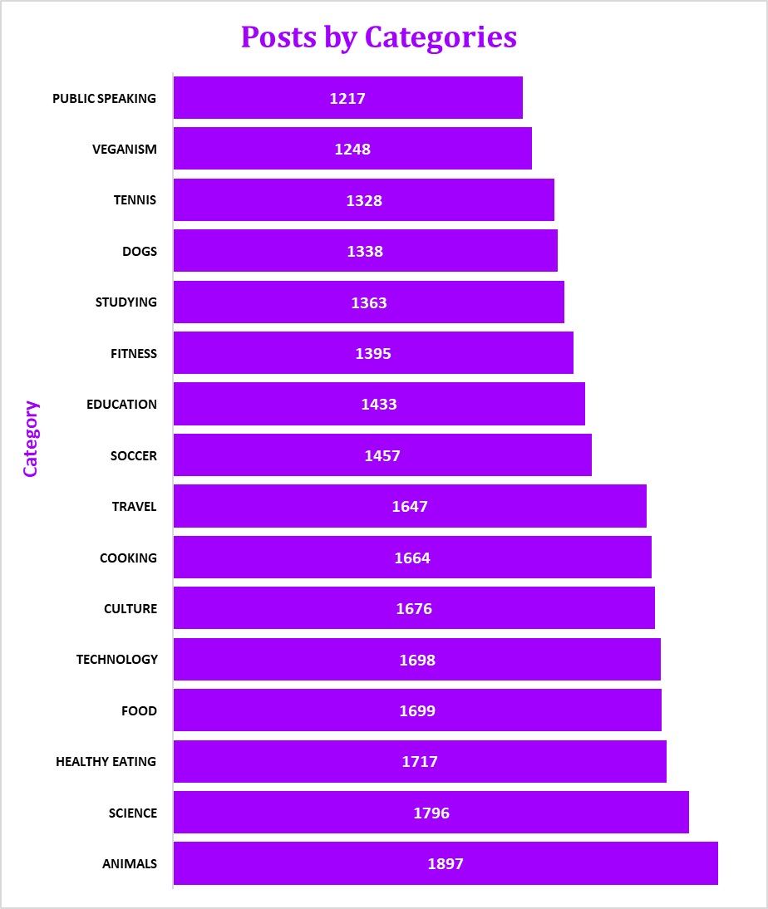
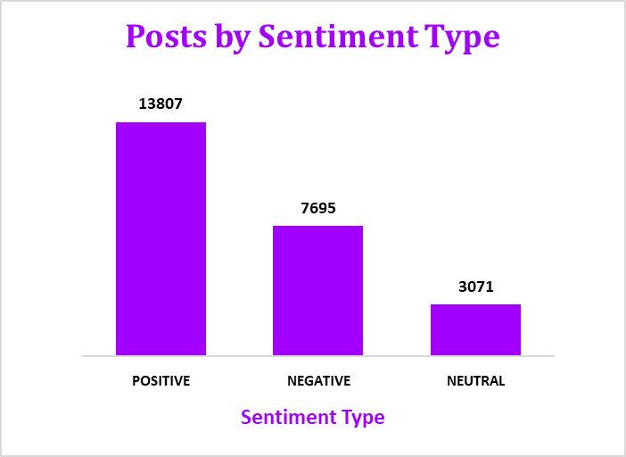


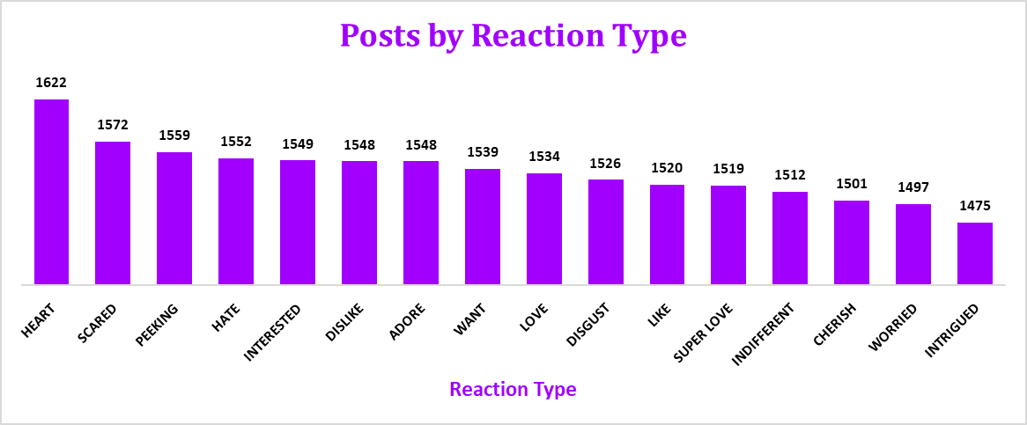

Slide 11

Summary
Analysis:
As we see Animals and Science are the two most popular categories of content, It shows that people enjoying “Factual” and “Real life” content the most.
Insight:
In the top 5 categories food is the common theme with ‘Healthy Eating’ ranking the highest. This is the indication to the audience within the user base. We suggest you could use this insight to create a campaign and work with healthy eating brands to boost user engagement.
Action:
This ad-hoc analysis is insightful, But it’s time to take action i.e., analysis into large scale production for real-time understanding of your business.

Slide 12
Thank you!
ANY QUESTIONS?

